Slide 1
Customer Journey Experience

Slide 2
What is Customer journey map?
The customer journey is the complete sum of experiences that customers go through when interacting with your company and brand. Instead of looking at just a part of a transaction or experience, the customer journey documents the full experience of being a customer.

Slide 3
Customer journey map For Product Owners
PRODUCT OWNERS wants to understand what’s causing user abandonment and in which journeys abandonment is occurring?
They want to know where users are struggling and how those struggles affect revenue.
They want to drive retention and share-of-wallet and typically uses Solutions like adobe or google Analytics.

Slide 4
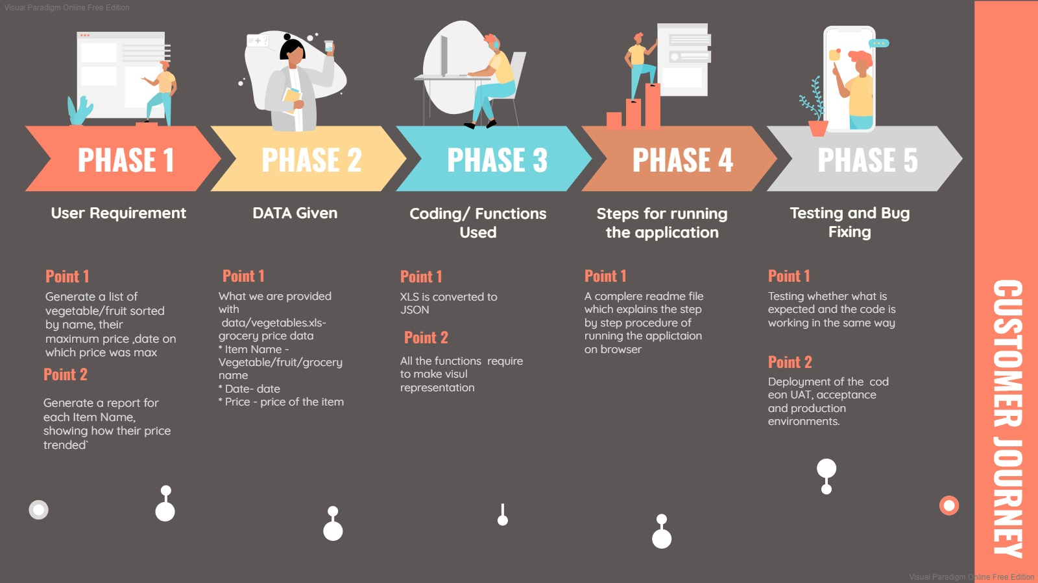

Slide 5
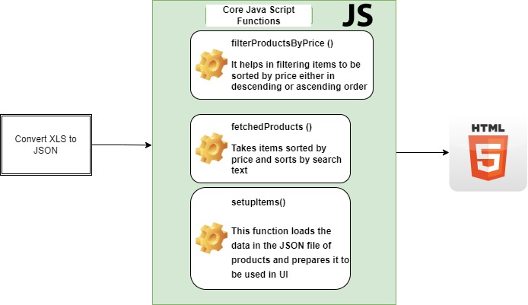
Code flow diagram

Slide 6
THANK YOU

